Slide 1


Marshalling Arguments
Implementation of remote procedure calls
Transfer of arguments
CLIENT
SERVER
Results

Slide 2
Marshalling Arguments
Transfer of message data requires encoding and decoding of the message data.
For RPCs this operation is known as Marshaling and involves the following Actions:
Taking the arguments of a client process or the
result of a server
Encoding the message data of step 1 above on the sender's computer.This encoding process involves the conversion of program objects into a stream form that is suitable for transmission and Placing them into a message buffer.
Decoding of the message data on the receiver's
Computer.The reconstruction of program objects from the message data that was received in stream form.

Slide 3
Marshalling Arguments
Marshalling procedure may be classified as
Provided as a part of the RPC software- Marshalling procedures for scalar data types and compound types build from the scalar ones
Those that are defined by the users of the RPC system- Marshalling procedures for user defined data types and data types that include pointers
A good RPC system
generate in-line marshaling code for every remote call
it is difficult to achieve this goal because of the large amounts of code

Slide 4
SERVER MANAGEMENT
Issues in server management are server implementation and server creation.
Server Implementation
1. Stateful Servers –Client state info is stored
Open (filename, mode): This operation is used to open a
file identified by filename in the specified mode.
Read (fid, n, buffer): This operation is used to get n
bytes of data from the file
Write (fid, n, buffer): On execution of this operation, the server takes n bytes of data
Seek (fid, position): causes the server to change the value of the read write pointer
Close (fid): This statement causes the server to delete from its file-table the file state

Slide 5
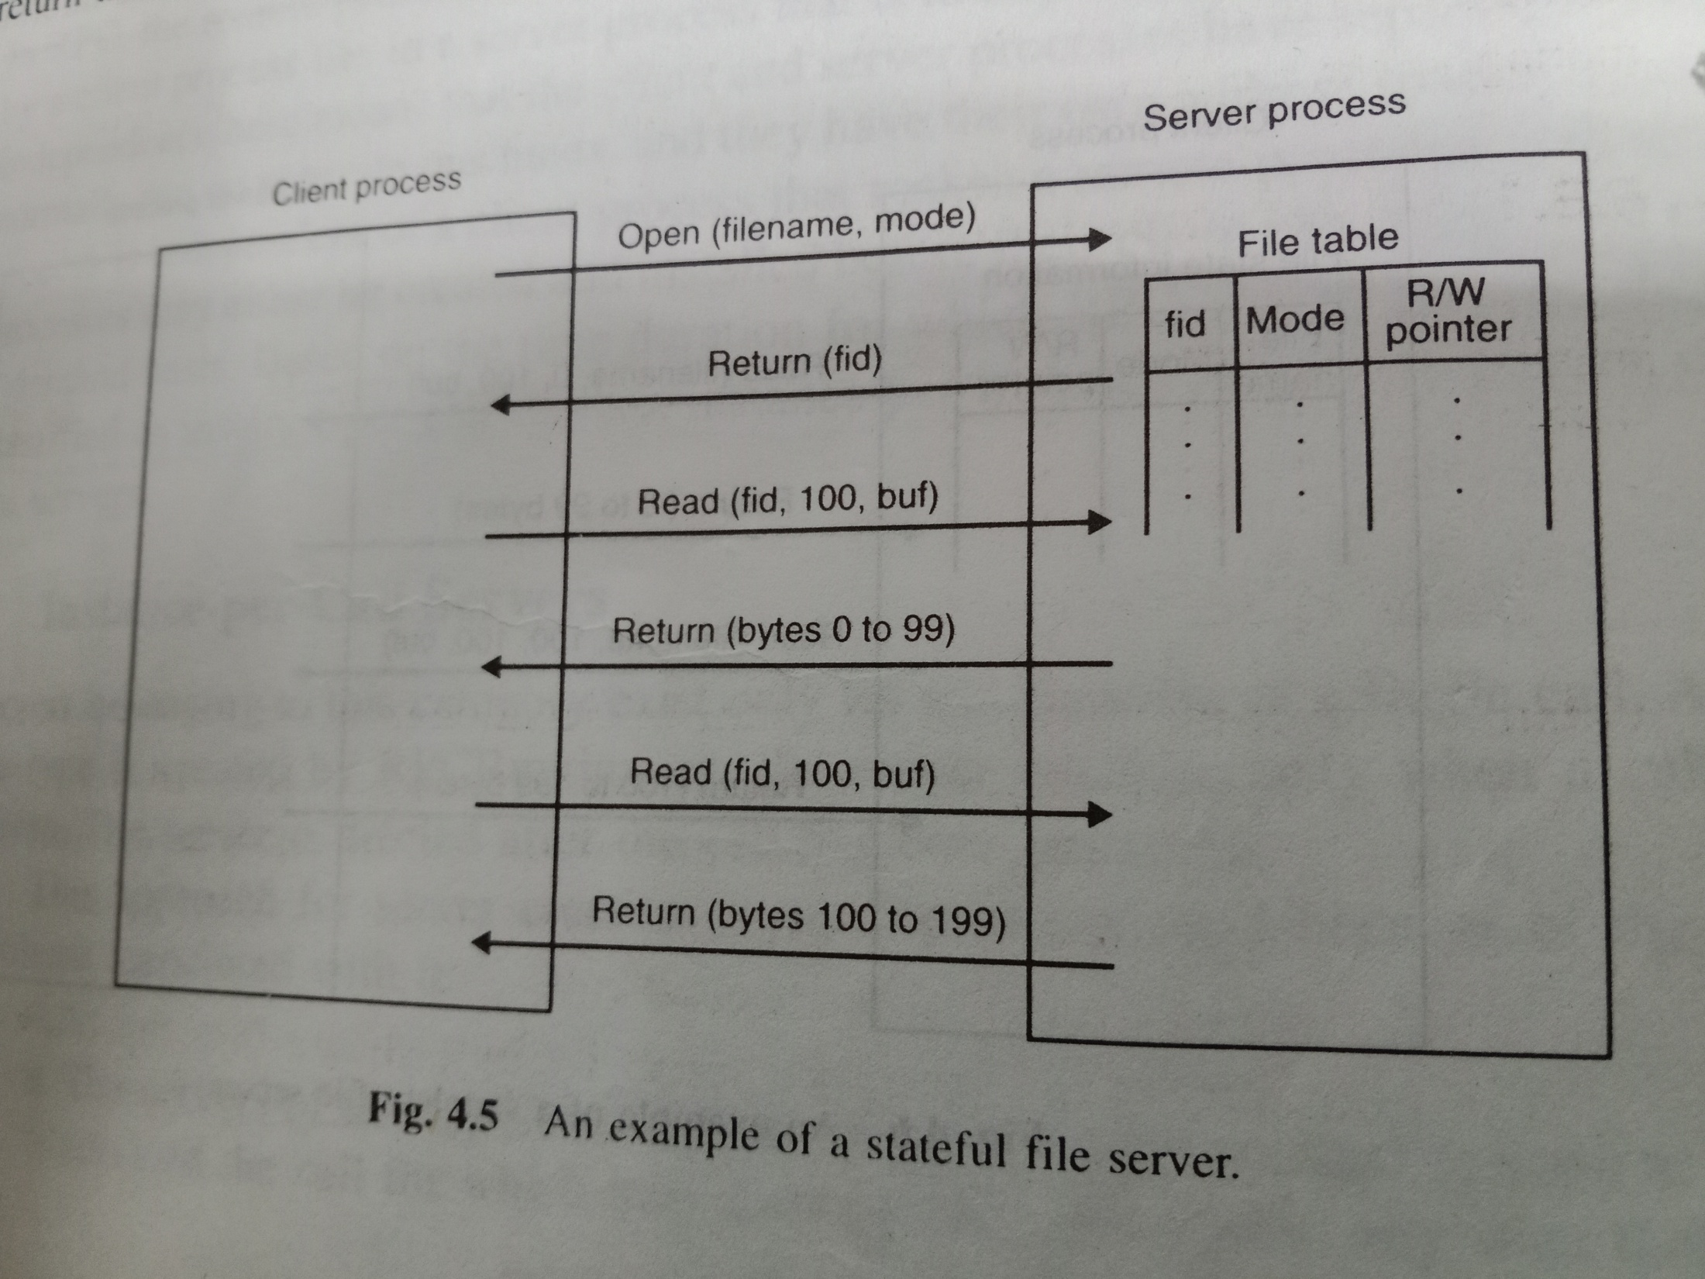

Slide 6
Stateless server
Read (filename,position,n,buffer)
Write(filename,position,n,buffer)

Slide 7
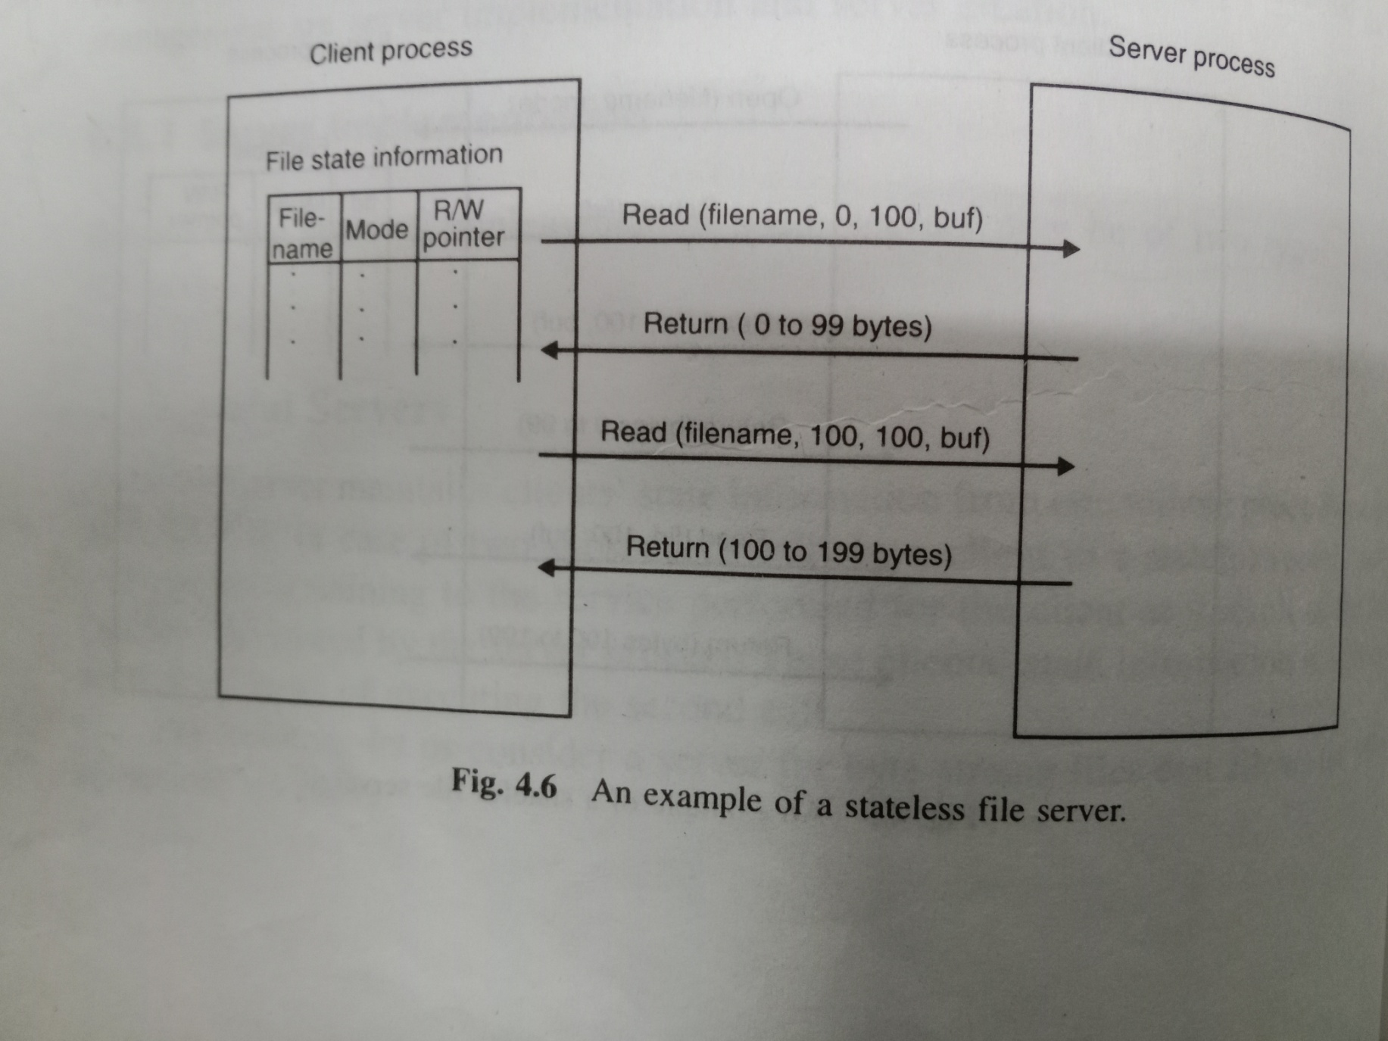

Slide 8
Server Creation Semantics
The remote procedure to be executed is totally independent of the client process.
Based on the time duration for which RPC servers survive, they may be classified as
Instance-per-call servers,
Instance-per-transaction or Session servers
Persistent servers.

Slide 9
Server Creation Semantics
Instance-per-Call Servers
Servers belonging to this category exist only for the duration of a single call.
A server of this type is created by RPC Runtime on the server machine only when a call message arrives.
The server is deleted after the call has been executed.

Slide 10
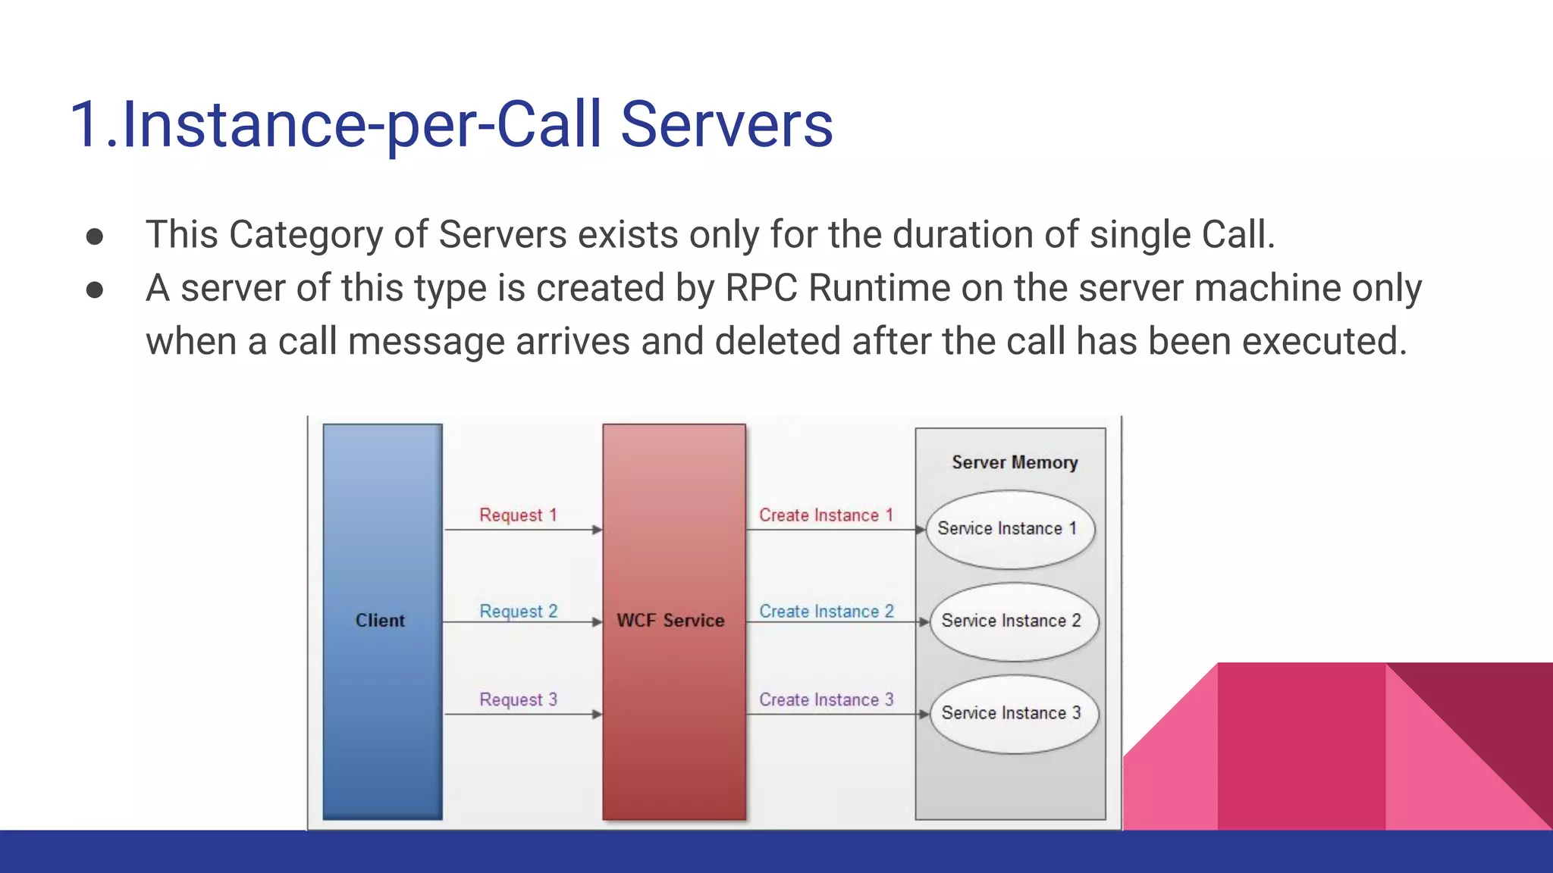

Slide 11
Server Creation Semantics
The servers of this type are stateless because they are killed as soon as they have serviced.
The involvement of OS to preserve inter call state information will make the remote procedure calls expensive (resource allocation and de alloaction done multiple times)
If it is maintained by the client process, the state information must be passed to and from the server with each call.
Will lead to the loss of data abstraction across the client-server
When same server has to be invoked successively – more expensive.

Slide 12
Server Creation Semantics
Instance-per-Session Servers
Servers exist for the entire session
can maintain inter-call state information
The overhead involved in server creation, destruction for a client-server session that involves a large number of calls is also minimized.
There is a server manager for each type of service. Server managers are registered with binding agent. Client contacts binding agent which in turn provides details of server manager based on the service request
Client contacts server manager asks to create server for it. After creation passes back its address to the client. Client contacts server directly and destroyed by server manager when client informs that no longer needed

Slide 13
Server Creation Semantics
Persistent Servers
Can be shared by more than one clients – No creation only sharing takes place
Servers are usually created and installed before the clients that use them.
Client contact binding agent-Minimum number of clients currently bound to it and returns the address of the selected server to the client.
The client then directly interacts with that server.
Manage several sets of state information.
Improves performance and reliability

Slide 14
Call SEMANTICS
Normal functioning of an RPC may get disrupted due to
The call message gets lost.
The response message gets lost.
The callee node crashes and is restarted.
The caller node crashes and is restarted.

Slide 15
Call SEMANTICS
Possibly or may be
This is the weakest semantics
In this method, to prevent the caller from waiting indefinitely for a response from the callee, a timeout mechanism is used.
The caller waits until a pre-determined timeout period and then continues with its execution.
Does not guarantee anything about the receipt of the call message.
The response message is not important for the caller

Slide 16
Call SEMANTICS
Last one – Retransmission
suppose process PI of node N1 calls
procedure Fl on node N2, which in turn calls
procedure F2 on node N3.(started executing)
Node N1 crashes.
Node N1 's processes will be restarted, and
PI's call to F1 will be repeated. The second invocation of FI will again call procedure F2 on node N3. Unfortunately, node N3 is totally unaware of node N1 crash.
Therefore procedure F2 will be executed twice on node N3 and N3 may return the results of the two executions of F2 in any order

Slide 17
Call SEMANTICS
The basic difficulty in achieving last-one semantics is caused by orphan calls.
An orphan call is one whose parent (caller) has expired due to a node crash.
To achieve last-one semantics, these orphan calls must be terminated before restarting the crashed processes
Killing by “orphan extermination”

Slide 18
Call SEMANTICS
Last of many
A simple way to neglect orphan calls is to use call identifiers to uniquely identify each call. When a call is repeated, it is assigned a new call identifier.
Each response message has the corresponding call identifier associated with it.
A caller accepts a response only if the call identifier
associated with it matches with the identifier of the
Most recently repeated call; otherwise it ignores the response message.

Slide 19
Call SEMANTICS
Atleast once
This is an even weaker call semantics than the last- of-many call semantics.
Guarantees that the call is executed one or more times but does not specify which results are returned to the caller.
can be implemented simply by using timeout- based retransmissions
if there are any orphan calls, it takes the result of the first response message and ignores the others, whether or not the accepted response is from an orphan.

Slide 20
Call SEMANTICS
Exactly once
This is the strongest and the most desirable call semantics because it eliminates the
Possibility of a procedure being executed more than once
No matter how many times a call is retransmitted. The last-one, last-of-many, and at-least-once call semantics cannot guarantee this

Slide 21
Call SEMANTICS
The main disadvantage of these cheap semantics is that, if a procedure is executed more than once with the same parameters, the same results and side effects will be produced
ReadNextRecord(Filename)
ReadRecordN(Filename, N)
AppendRecord(Filename, Record)
GetLastRecordNo(Filename)
WriteRecordN(Filename, Record, N)
To append
Last=GetLastRecordNo(Filename)
WriteRecordN(Filename, Record, last)

